Slide 1

新人培訓

Slide 2

目標
Notes:
https://unsplash.com/photos/brown-wooden-table-and-chairs-NCUrnrfwhhg

Slide 3
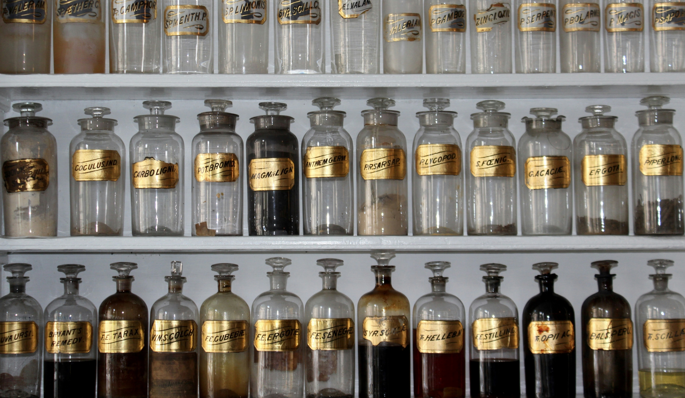
阻礙
Notes:
https://unsplash.com/photos/clear-glass-jar-lot-on-shelf-0tfz7ZoXaWc

Slide 4

努力
Notes:
https://unsplash.com/photos/brown-wooden-drawer-lRoX0shwjUQ

Slide 5
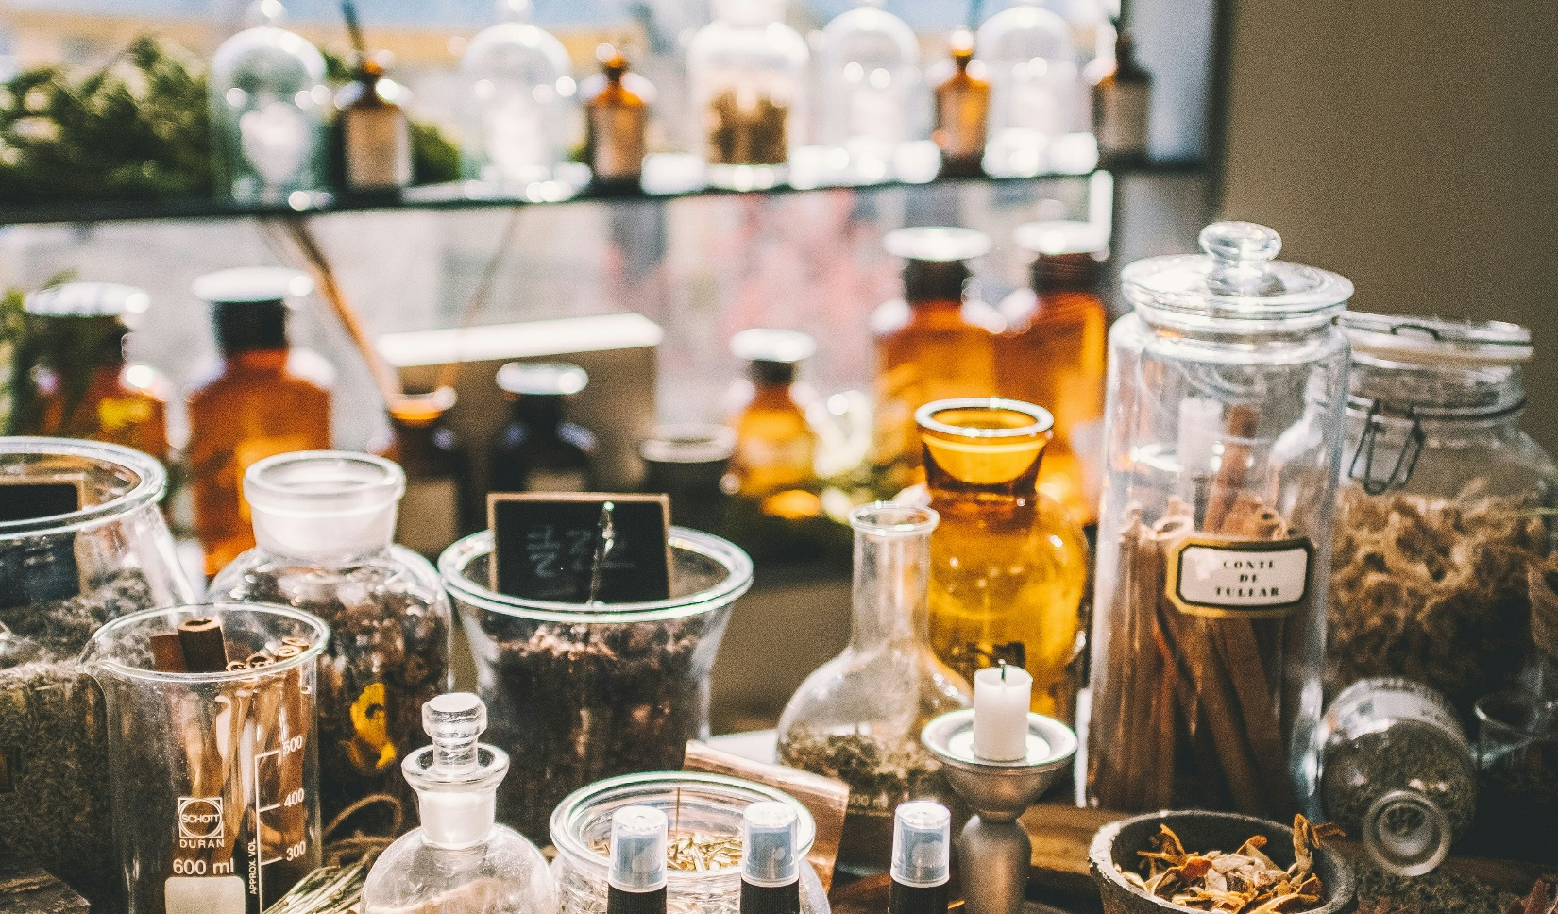
結果
Notes:
https://unsplash.com/photos/assorted-item-lot-ur2zmbseUIA

Slide 6

意外
Notes:
https://unsplash.com/photos/man-in-black-hoodie-standing-on-snow-covered-ground-during-daytime-UScFXZ0CeR0

Slide 7
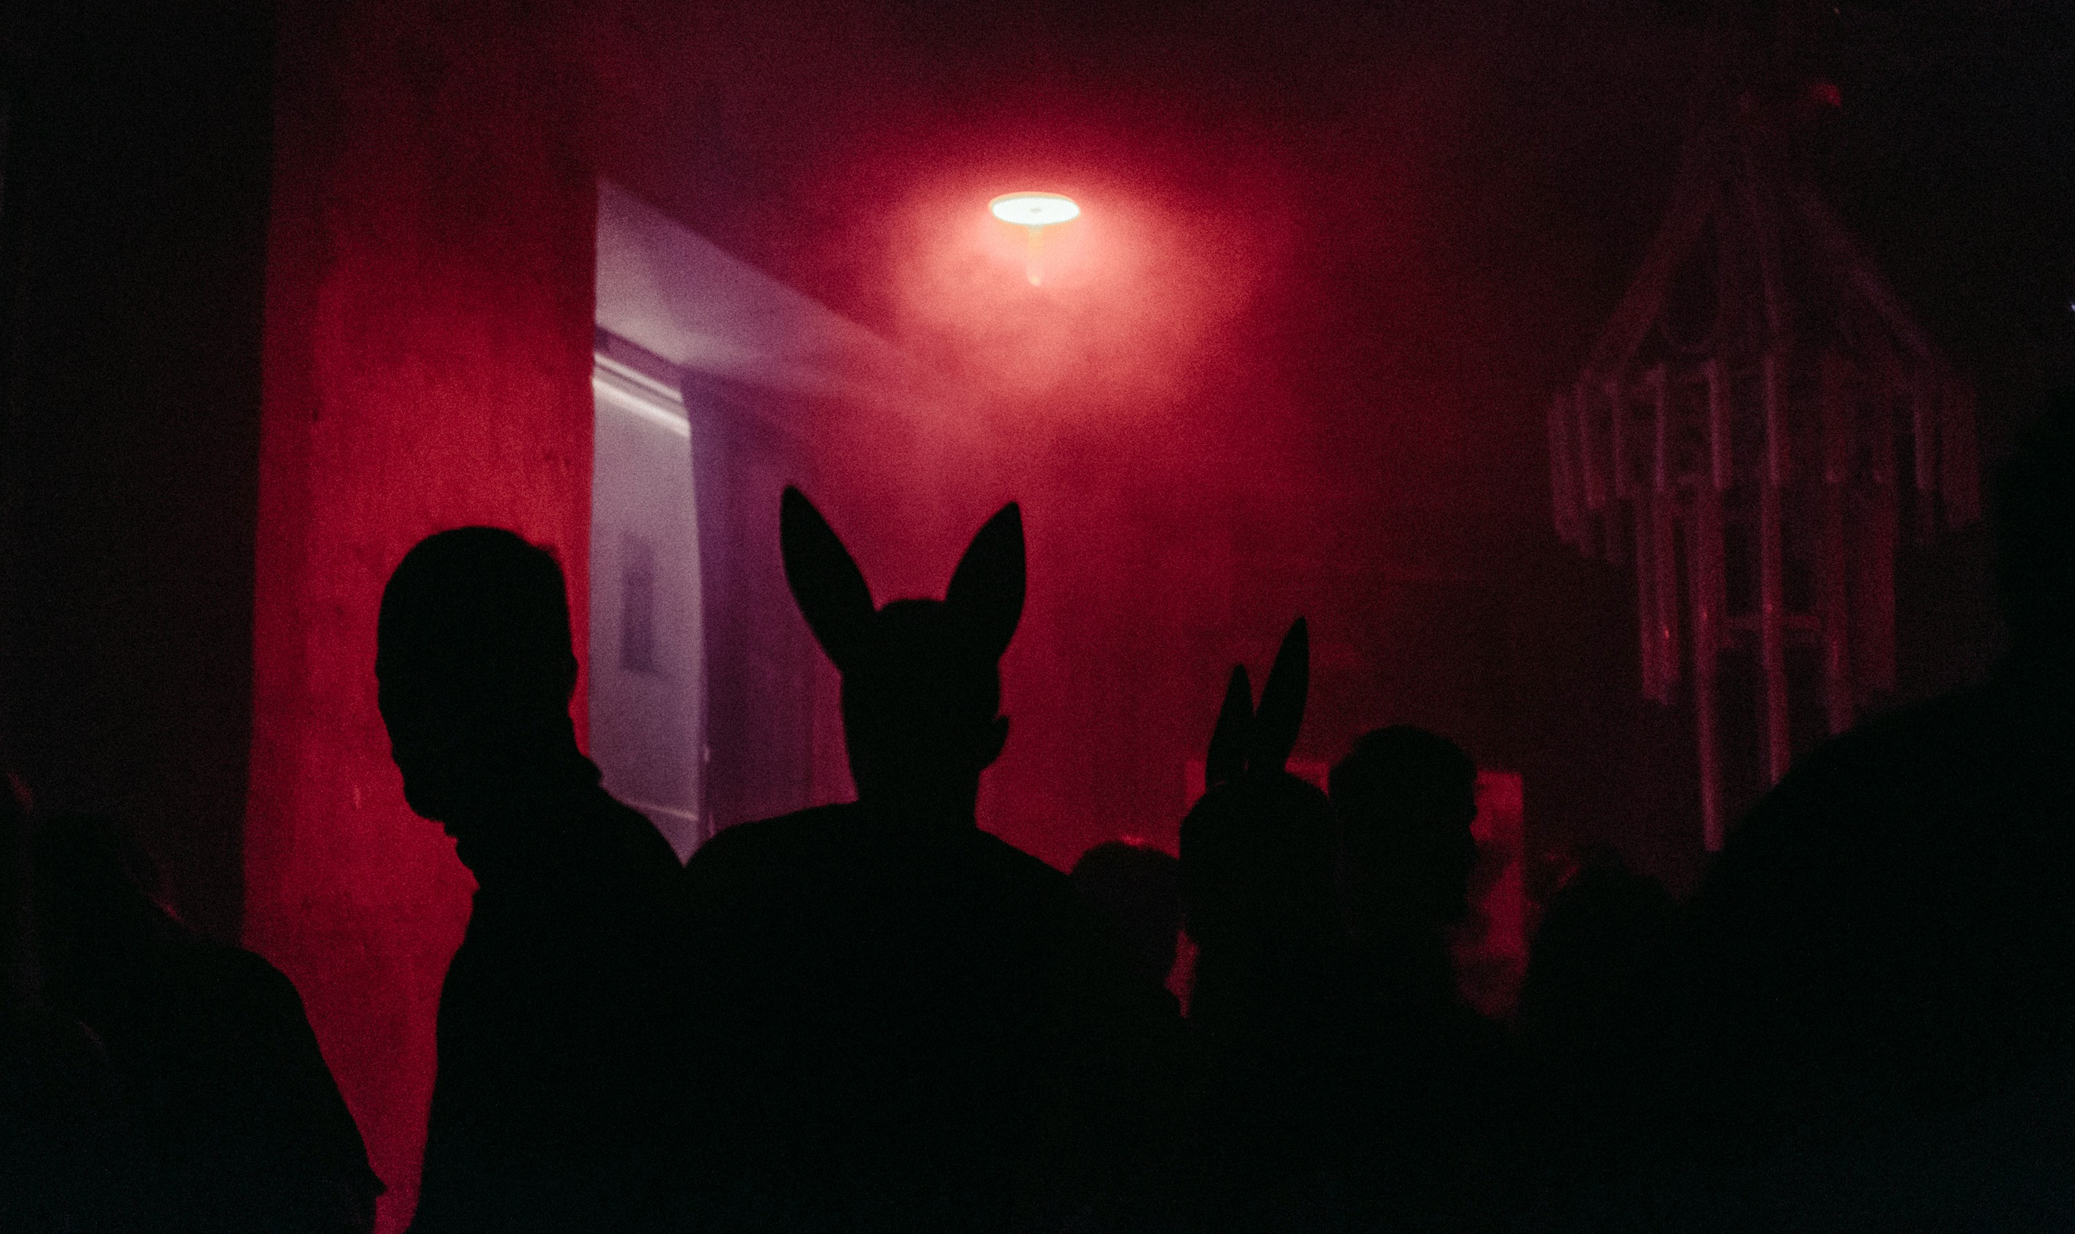
轉彎
Notes:
https://unsplash.com/photos/a-group-of-people-standing-in-front-of-a-red-light-SbPUMwGYzLo

Slide 8
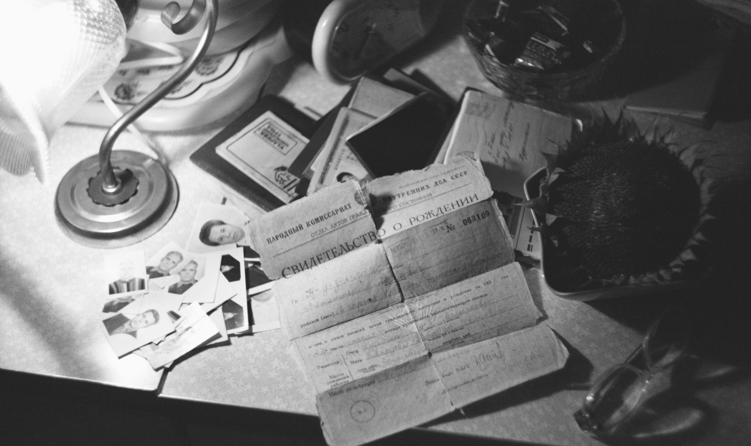
結局
Notes:
https://unsplash.com/photos/a-cluttered-desk-with-papers-and-a-stethoscope-P0xyehNJEK8

